Slide 1

Comparing parameter estimation methods in different period scales of Pyeong-hwa dam inflow data
Earth and Environmental Sciences, Jiyun Kim
Statistical Hydrology

Slide 2

Contents
Study area
강원도 화천군 평화의 댐
Method
Maximum Likelihood Estimation (MLE)
L – moments
Result
Parameter estimation
Optimal probability distribution
Conclusion

Slide 3


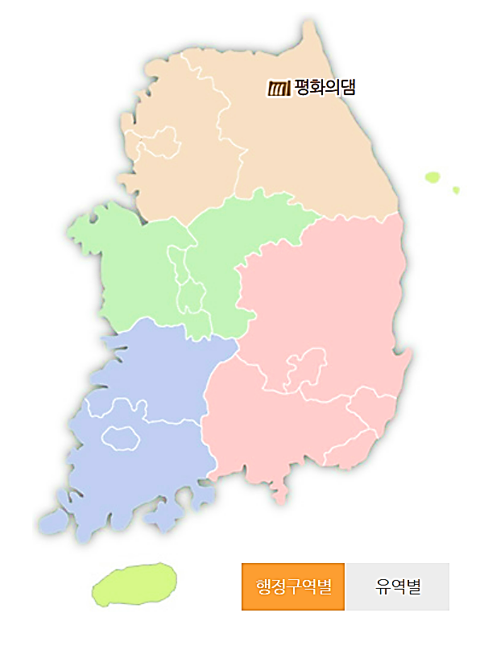
Study area
강원도 화천군, 평화의 댐
Specifications
유형 | 홍수조절댐 | 하천 | 북한강
유역면적 (km2) | 3208 | 계획홍수위 (EL.m) | 264.6
총저수용량 (백만m3) | 2630 | 홍수조절용량 (백만m3) | 2630

Slide 4
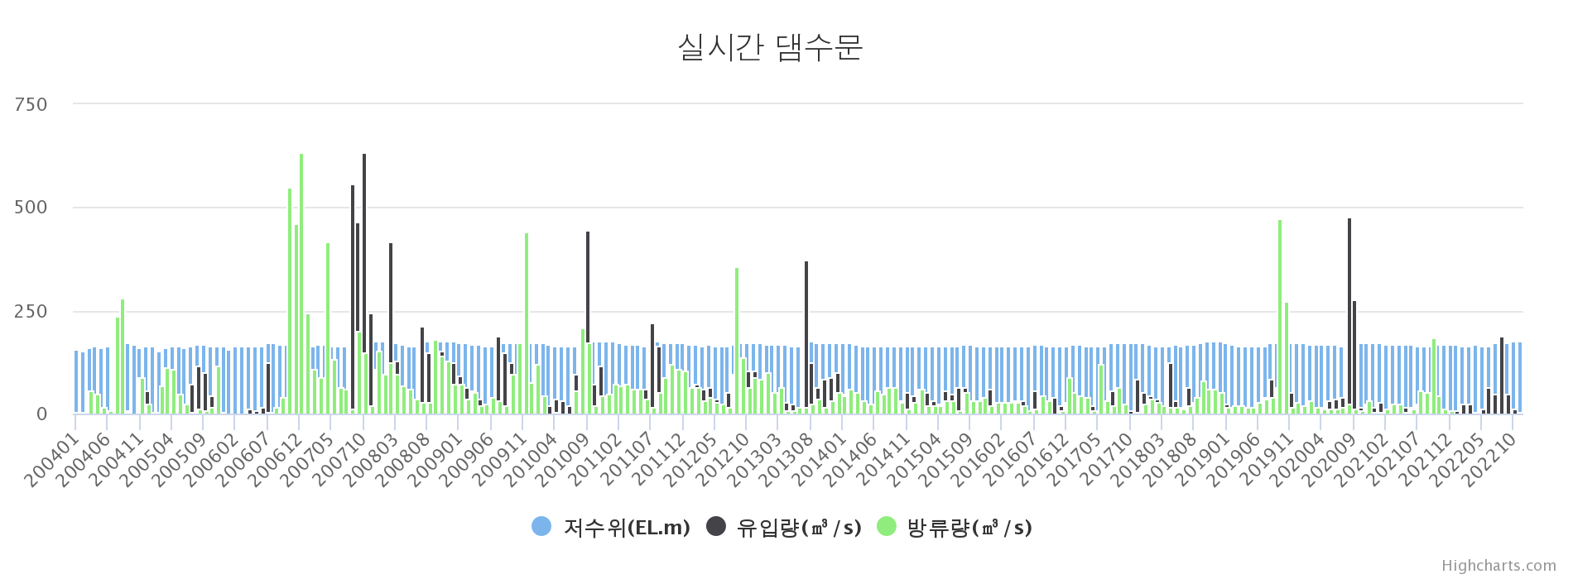
Study area
Real-time dam gate data
Statistical summary
Period | Average (m3/s) | Standard Deviation (m3/s) | Coef. of Variance | Coef. of Skewness
2004/01~2022/11 | 59.66 | 92.12 | 1.54 | 0.27

Slide 5
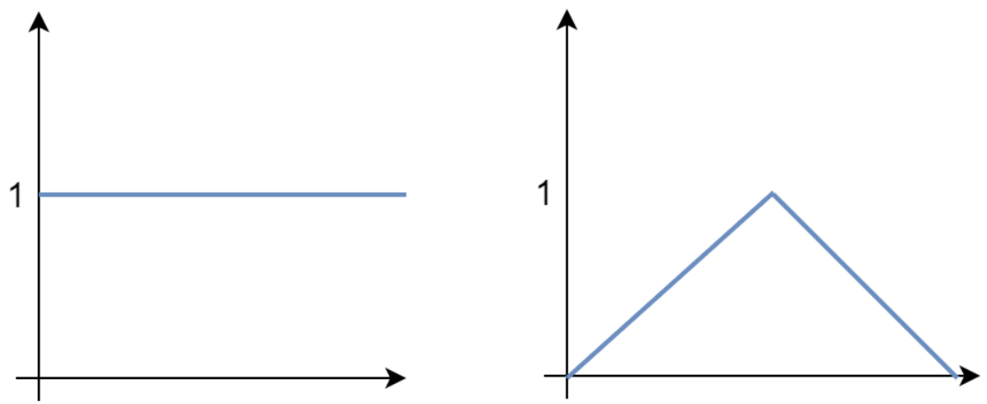

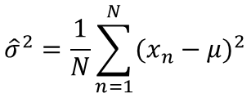








Method – Maximum likelihood
Likelihood
Log- likelihood
Which distribution is likely to derive data $X$ ?
$$E\left(θ\right)=lnL\left(θ\right)=−\sum_{n=1}^{N}{ln⁡(p\left(x_{n} | θ\right))}$$
Maximum likelihood
$$\frac{∂}{∂μ}E\left(μ,σ\right)=−\sum_{n=1}^{N}{\frac{\frac{∂}{∂μ}p\left(x_{n} | μ,σ\right)}{p\left(x_{n} | μ,σ\right)}}$$
$$=−\sum_{n=1}^{N}{\frac{2(x_{n}−μ)}{2σ^{2}}}$$
$$L\left(θ\right)=p\left(X | θ\right)$$
$$=\frac{1}{σ^{2}}\left(\sum_{n=1}^{N}{((x_{n}−Nμ))}\right)$$
$$p\left(x_{n} | θ\right)=\frac{1}{\sqrt{2πσ}}exp\left\{−\frac{{(x_{n}−μ)}^{2}}{2σ^{2}}\right\}$$
$$L\left(θ\right)=\prod_{n=1}^{N}{p\left(x_{n} | θ\right)}$$
$$\hat{μ}=\frac{1}{N}\sum_{n=1}^{N}{x_{n}}$$
$${\hat{σ}}^{2}=\frac{1}{N}\sum_{n=1}^{N}{{(x_{n}−μ)}^{2}}$$

Slide 6








Method – L moments
Probability weighted moments
$$β_{r}=E\left[X\left\{F{(X)}^{r}\right\}\right]$$
$F(X)$: Ascending order of $X$
$r$: Moment degree
L-moments
Express L-moment as a linear combination of probability weighted moments
L-skewness
$$λ_{1}=β_{0}$$
$$τ_{3}=\frac{λ_{2}}{λ_{1}}$$
$$λ_{2}={2β}_{1}−β_{0}$$
$$λ_{3}={{6β}_{2}−6β}_{1}+β_{0}$$
L-kurtosis
$$λ_{4}={{20β}_{3}−{30β}_{2}+12β}_{1}−β_{0}$$
$$τ_{4}=\frac{λ_{4}}{λ_{2}}$$

Slide 7
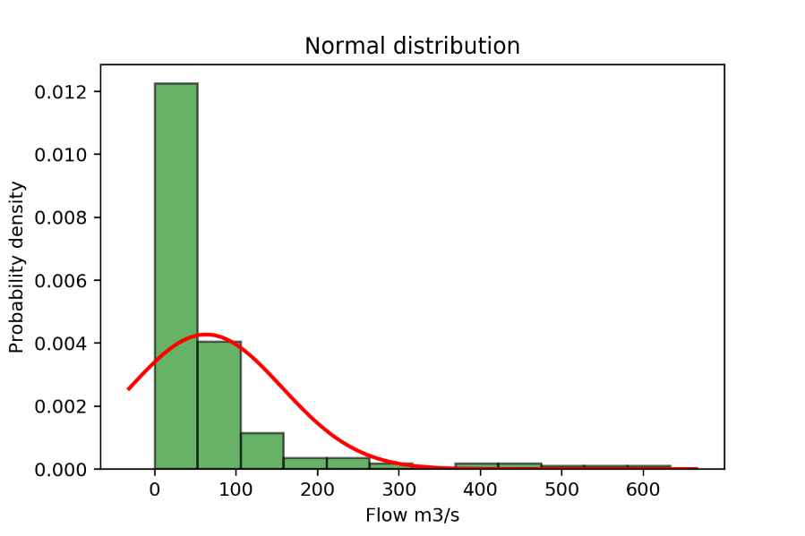
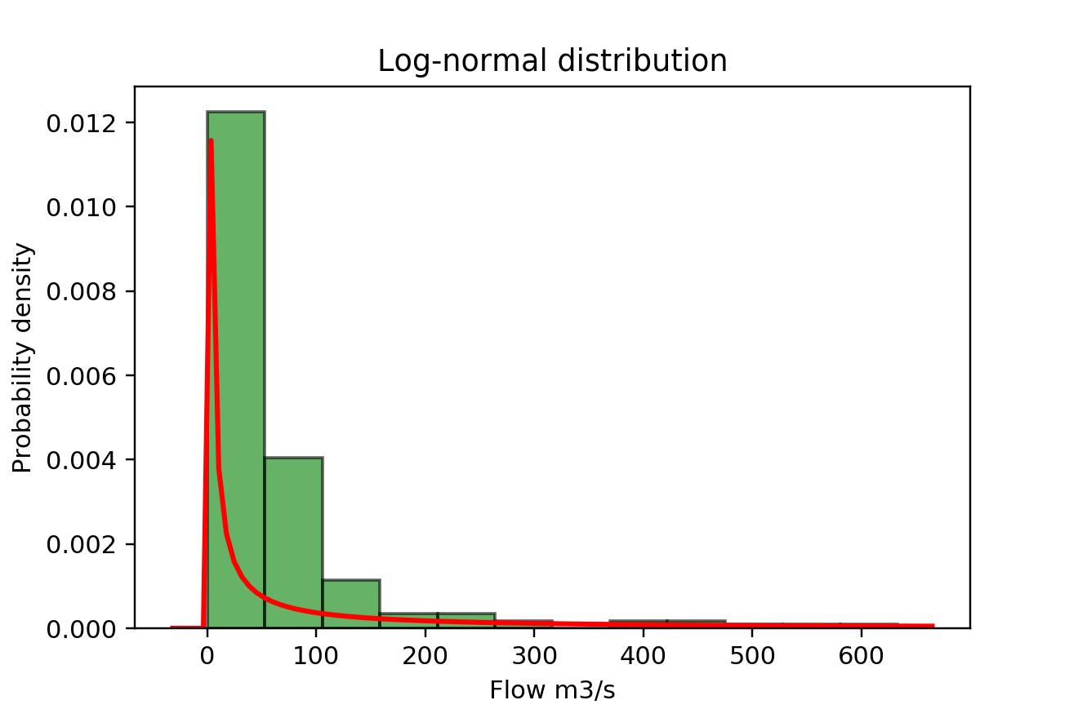
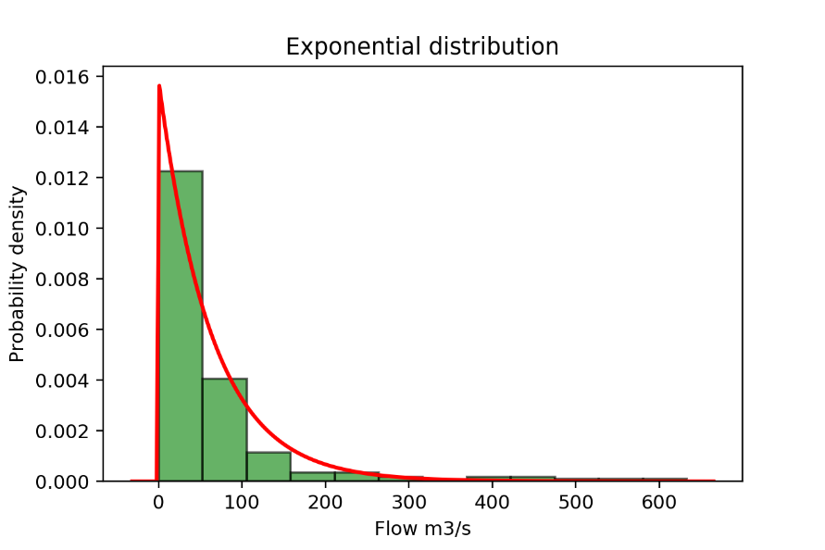
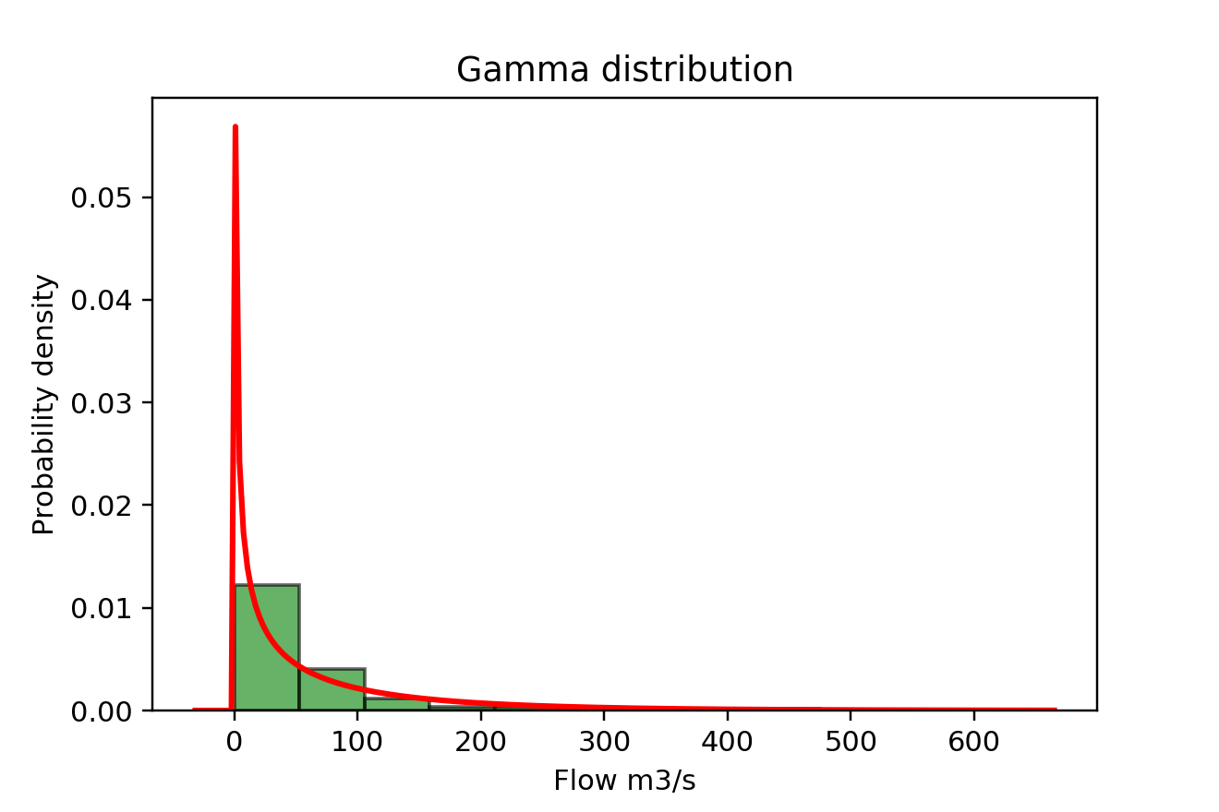
Results - Total

Slide 8
Results - Total
Distribution | Estimated parameters |  | Likelihood | AIC
Normal | Mean | 63.06 | -1285.95 | 2564.48
 | SD | 93.29
Log-normal | Mean log | 3.34 | -1114 | 2232
 | SD log | 1.52
Exponential | Rate | 0.016 | -1105.968 | 2213.94
Gamma | Shape | 0.75 | -1099.13 | 2202.25
 | Rate | 0.012

Slide 9
Results – L moments
Normal distribution
L-coefficients
Covarience of L-moments
L1 | 25.59
L2 | 17.57
L3 | 7.01
L4 | -0.18
L-skewness | 0.40
L-kurtosis | -0.01
 | L1 | L2 | L3 | L4
L1 | 11.98 | 5.01 | -2.33 | -4.26
L2 | 5.01 | 2.11 | -0.95 | -1.78
L3 | -2.33 | -0.95 | 0.49 | 0.84
L4 | -4.26 | -1.78 | 0.84 | 1.53
Log-normal distribution
L-coefficients
Covarience of L-moments
L1 | 12.65
L2 | 12.55
L3 | 12.34
L4 | 12.03
L-skewness | 0.98
L-kurtosis | 0.96
 | L1 | L2 | L3 | L4
L1 | 82.20 | 80.90 | 78.29 | 74.38
L2 | 80.90 | 79.60 | 77.02 | 73.14
L3 | 78.29 | 77.02 | 74.47 | 70.65
L4 | 74.38 | 73.14 | 70.65 | 66.93

Slide 10
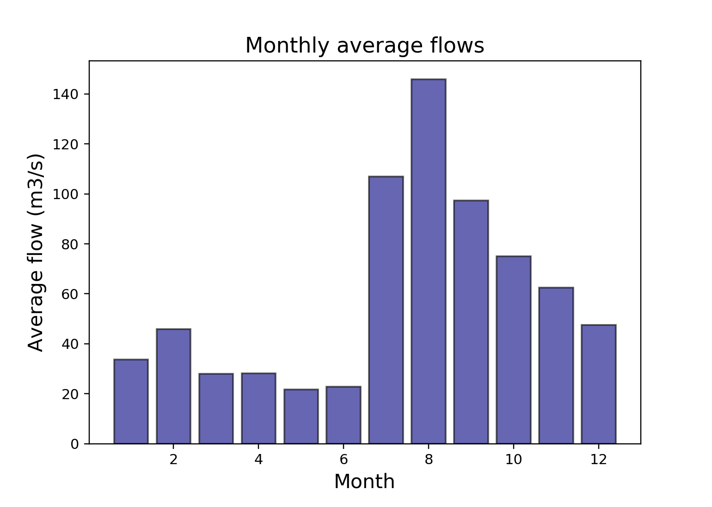
Results - August
Statistical summary
Period | Average (m3/s) | Standard Deviation (m3/s) | Coef. of Variance | Coef. of Skewness
2004~2022 August | 154.32 | 150.68 | 0.98 | 1.07

Slide 11
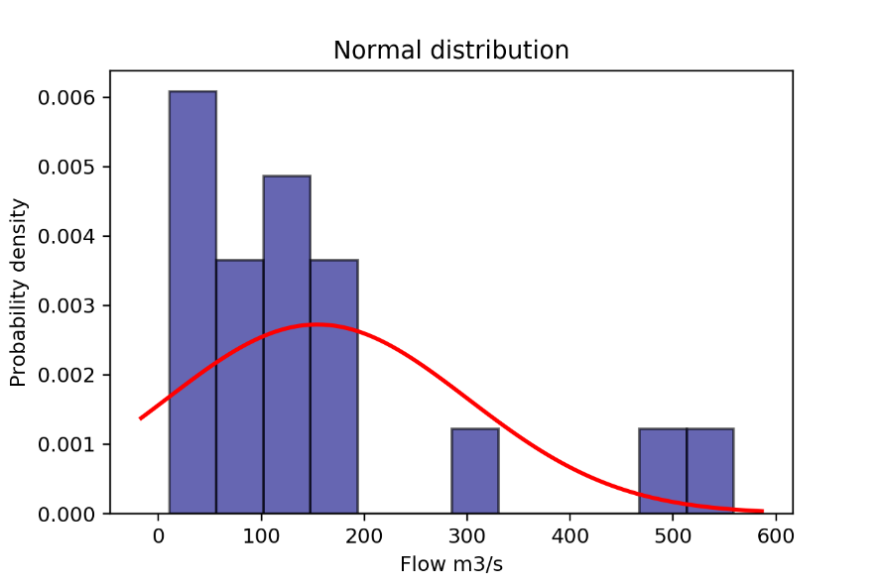
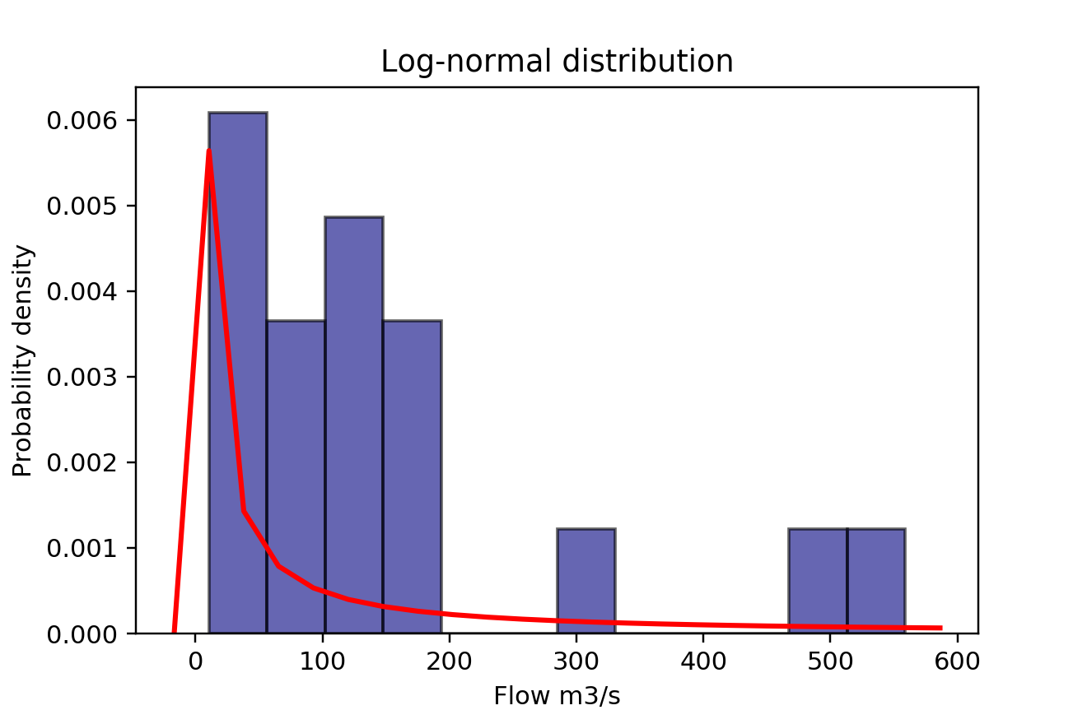
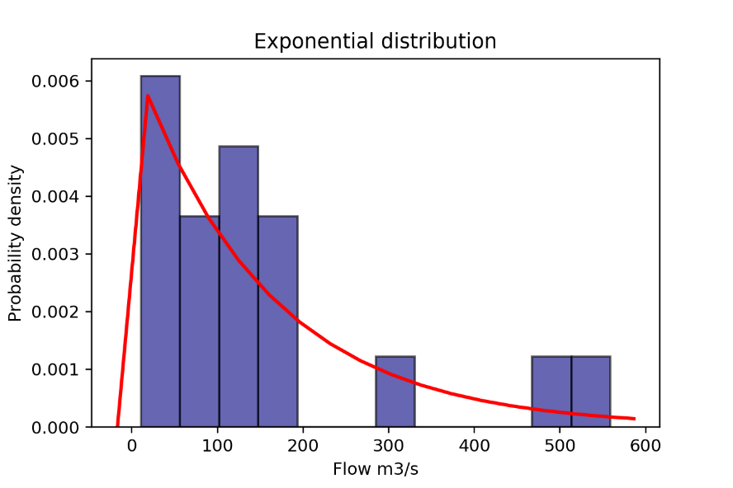
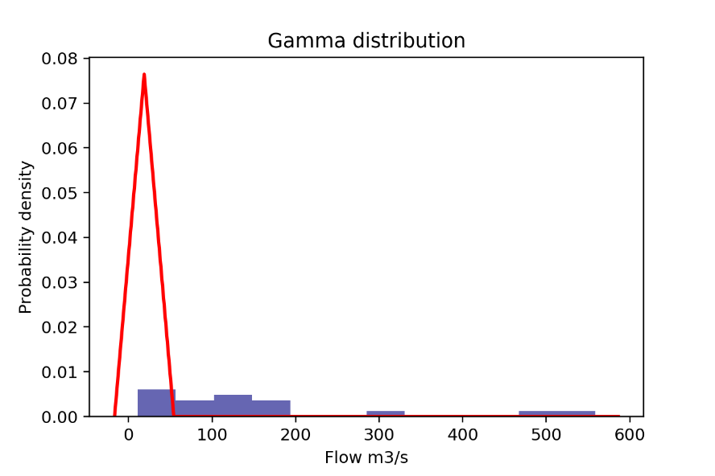
Results - August

Slide 12
Results - August
Distribution | Estimated parameters |  | Likelihood | AIC
Normal | Mean | 154.31 | -115.30 | 234.60
 | SD | 146.43
Log-normal | Mean log | 4.59 | -108.38 | 220.75
 | SD log | 1.01
Exponential | Rate | 0.0065 | -108.70 | 219.40
Gamma | Shape | 1.26 | -108.38 | 220.83
 | Rate | 0.008

Slide 13
Results – L moments
Normal distribution
L-coefficients
Covarience of L-moments
L1 | 1.52
L2 | 0.44
L3 | -0.03
L4 | -0.02
L-skewness | -0.07
L-kurtosis | -0.04
 | L1 | L2 | L3 | L4
L1 | 0.006 | -4.90×10-4 | -1.39×10-3 | 1.19×10-4
L2 | -0.005 | 3.17×10-4 | 3.17×10-5 | -1.56×10-4
L3 | -0.001 | 3.41×10-5 | 3.41×10-4 | -5.00×10-6
L4 | 0.0001 | -1.56×10-4 | -5.00×10-6 | 1.05×10-4
Log-normal distribution
L-coefficients
Covarience of L-moments
L1 | 1.56
L2 | 1.55
L3 | 1.53
L4 | 1.50
L-skewness | 0.99
L-kurtosis | 0.97
 | L1 | L2 | L3 | L4
L1 | 1.38 | 1.36 | 1.33 | 1.29
L2 | 1.36 | 1.34 | 1.32 | 1.27
L3 | 1.33 | 1.32 | 1.29 | 1.24
L4 | 1.29 | 1.27 | 1.24 | 1.20

Slide 14
Conclusion
Total monthly data among 2004/01~2022/11
Distribution | Estimated parameters |  | Likelihood | AIC
Normal | Mean | 63.06 | -1285.95 | 2564.48
 | SD | 93.29
Log-normal | Mean log | 3.34 | -1114 | 2232
 | SD log | 1.52
Exponential | Rate | 0.016 | -1105.968 | 2213.94
Gamma | Shape | 0.75 | -1099.13 | 2202.25
 | Rate | 0.012
August data among the period
Distribution | Estimated parameters |  | Likelihood | AIC
Normal | Mean | 154.31 | -115.30 | 234.60
 | SD | 146.43
Log-normal | Mean log | 4.59 | -108.38 | 220.75
 | SD log | 1.01
Exponential | Rate | 0.0065 | -108.70 | 219.40
Gamma | Shape | 1.26 | -108.38 | 220.83
 | Rate | 0.008

Slide 15
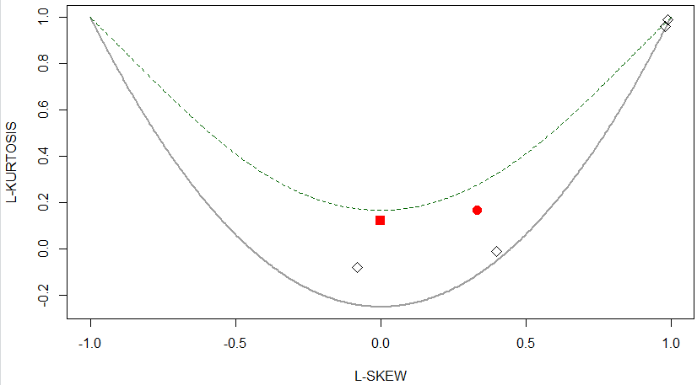
Conclusion
: Normal
: Log-normal
Total
L-skewness | 0.40
L-kurtosis | -0.01
L-skewness | 0.98
L-kurtosis | 0.96
: Normal (default)
L-skewness | -0.07
L-kurtosis | -0.04
L-skewness | 0.99
L-kurtosis | 0.97
: Exponential (default)
August

Slide 16


Thank You

